Slide 1

Branch: Computer Science Engineering
Subject-: OPERATING SYSTEMS ·
MODULE 2: 22CS207
Batch - 17
T. Anil Kumar : 241FA04090
Ch. Uhanjali : 241FA04493
T.Kedhar :241FA04E14
Rakesh Kumar : 241FA04F90
Submitted To :
Dr O. Bhaskar

Slide 2
Content:
01
02
03
Introduction
Aim
Problem Statement
What is paging and why does it matter?
Objectives of this presentation
Memory reference time calculations with and without TLB
04
05
Program
Conclusion
Code snippet simulating the paging system
Key takeaways and summary

Slide 3

Paging & Page Tables
Understanding memory management through paging, TLB optimisation, and practical implementation — a core concept in Operating Systems.
OPERATING SYSTEMS
MEMORY MANAGEMENT

Slide 4
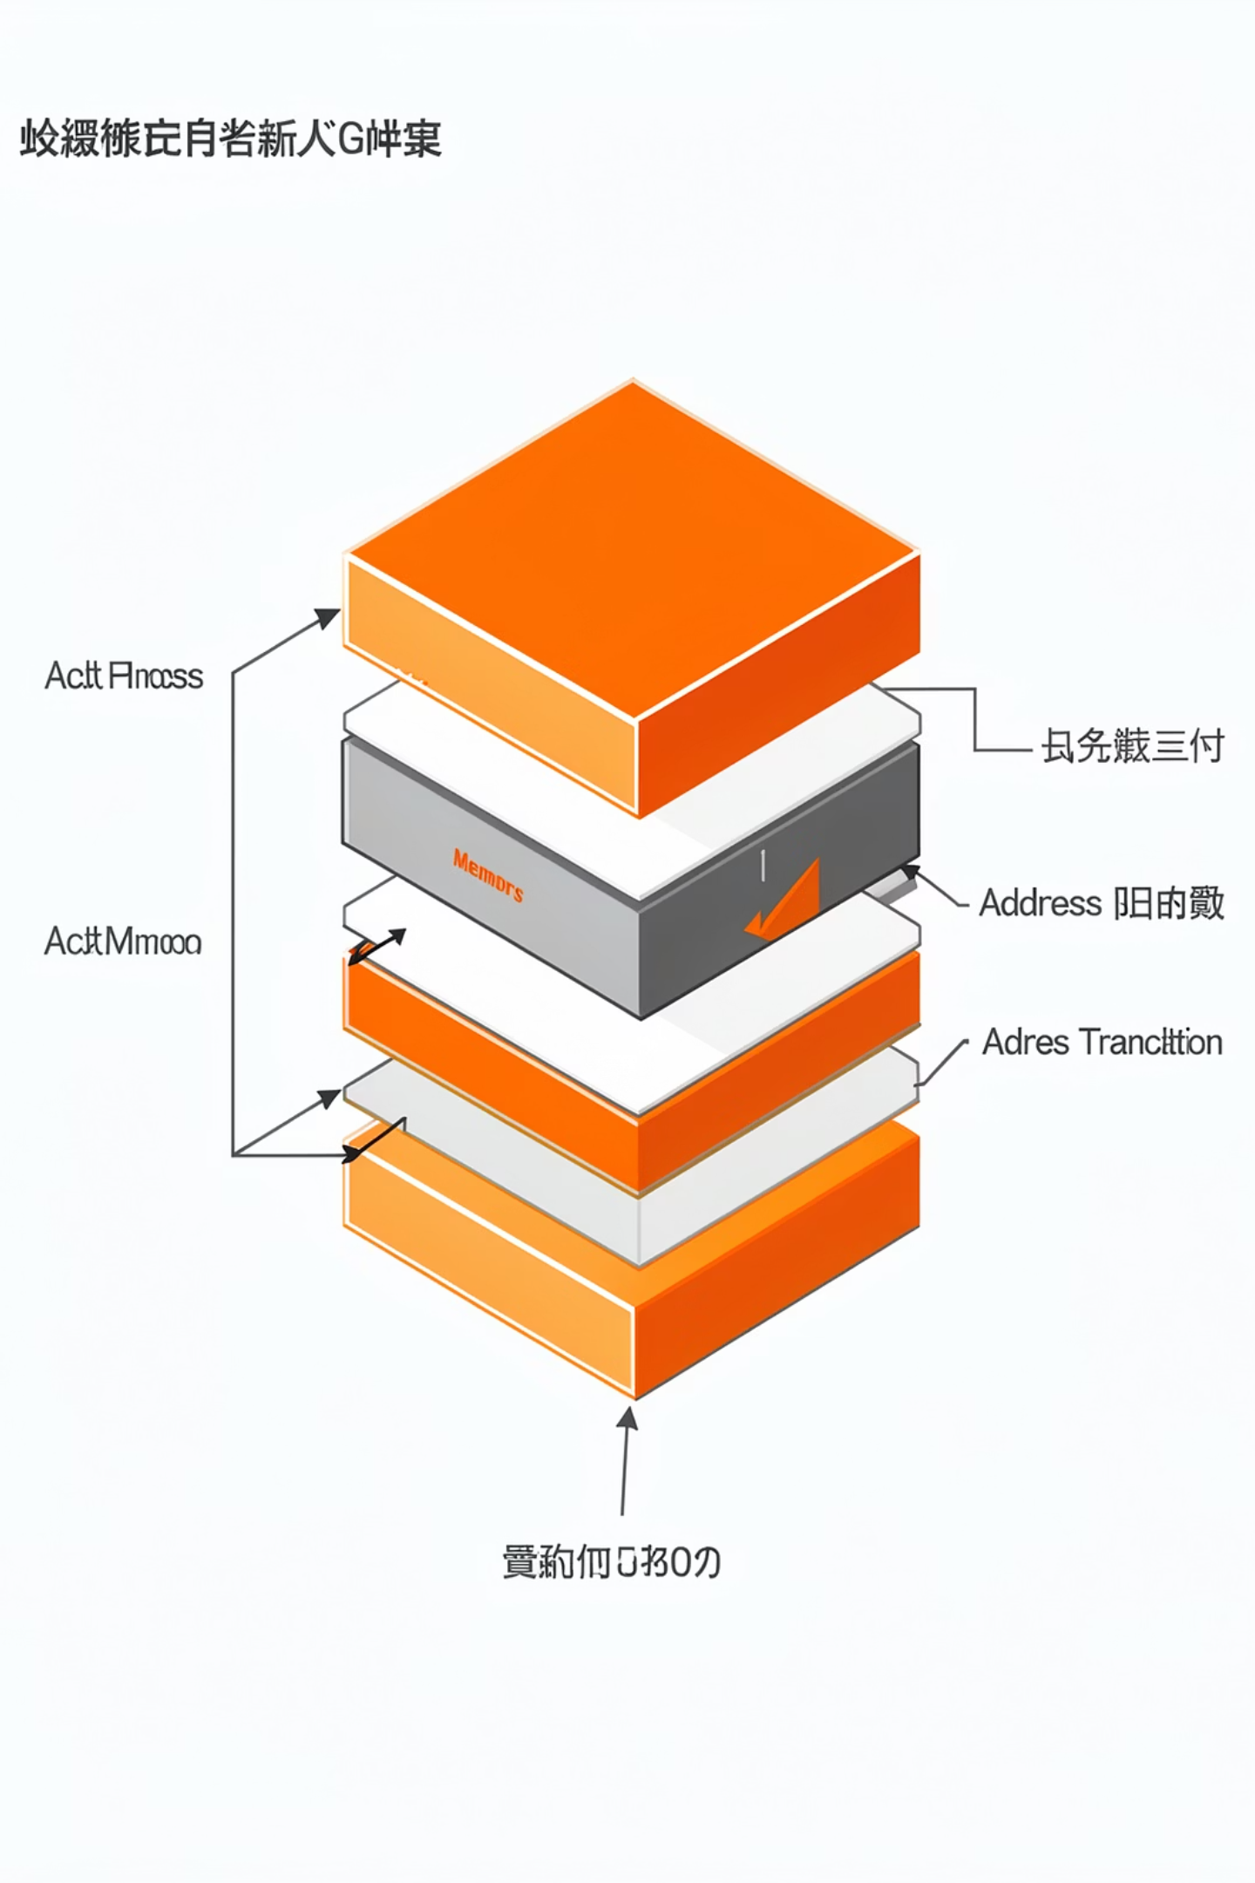
What is Paging?
Paging is a memory management scheme that eliminates the need for contiguous physical memory allocation. Logical memory is divided into fixed-size blocks called pages, and physical memory is divided into frames of the same size.
Logical Address
Page Table
Page Number + Offset
Maps pages to frames
Physical Address
Frame Number + Offset

Slide 5
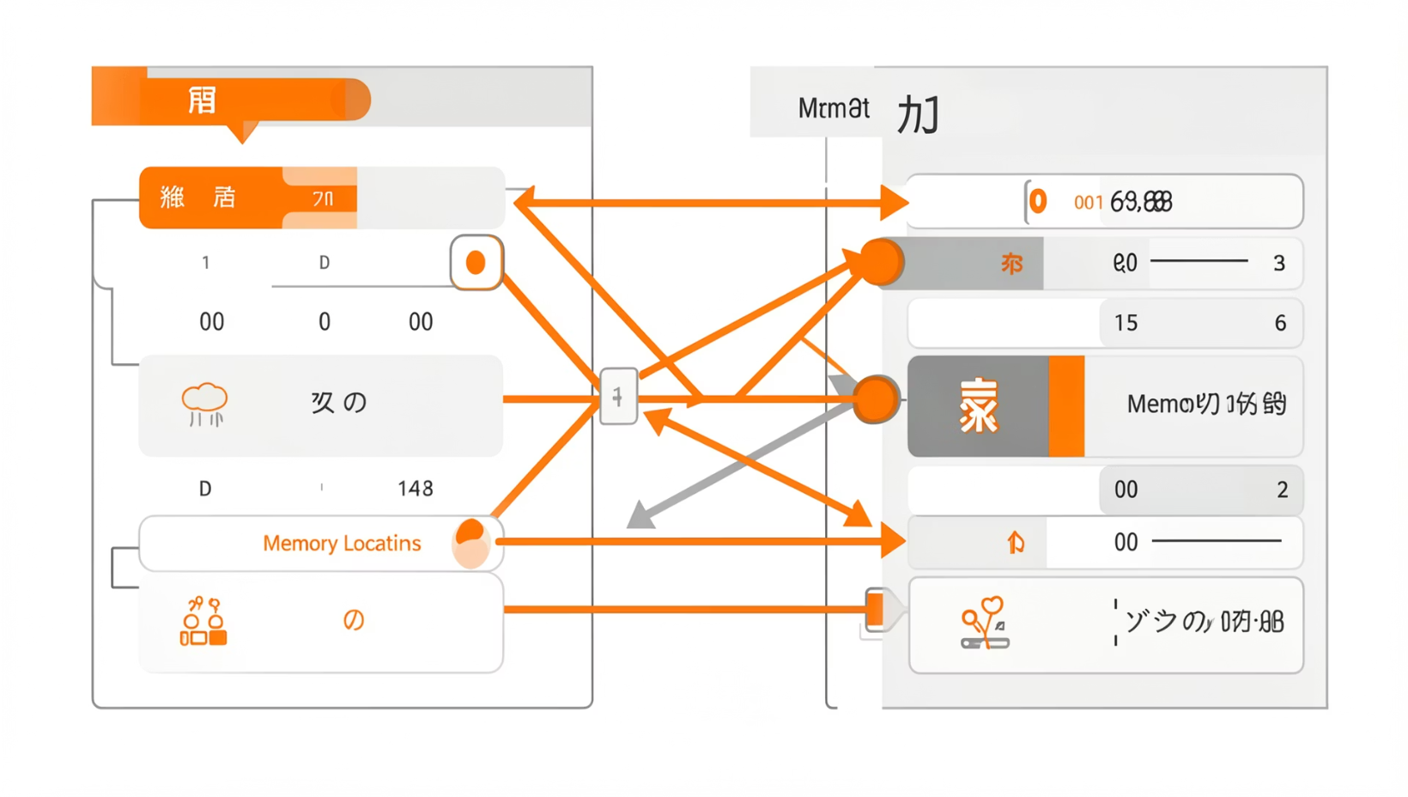
Purpose of Page Tables
The page table is the core data structure that enables paging. It is maintained by the OS for each process and serves the following purposes:
Address Translation
Protection
Presence Tracking
Maps virtual page numbers to physical frame numbers.
Stores read/write/execute permission bits for each page.
Indicates whether a page is currently in RAM or on disk.

Slide 6
Aim:
1
2
3
Understand Paging
Calculate Access Times
Implement in Code
Explain the purpose and mechanism of page tables in memory management.
Compute effective memory reference time with and without TLB.
Write a code snippet that simulates a basic paging system with TLB.

Slide 7

Problem Statement — Part B(i)
Given: A paging system with the page table stored in memory. A single memory reference takes. 200 nanoseconds
Question: How long does a paged memory reference take?
Step 1 — Page Table Lookup
Step 2 — Access Actual Data
Access page table in memory → 200 ns
Access the physical memory location → 200 ns
Total Effective Time
200 + 200 = 400 nanoseconds

Slide 8
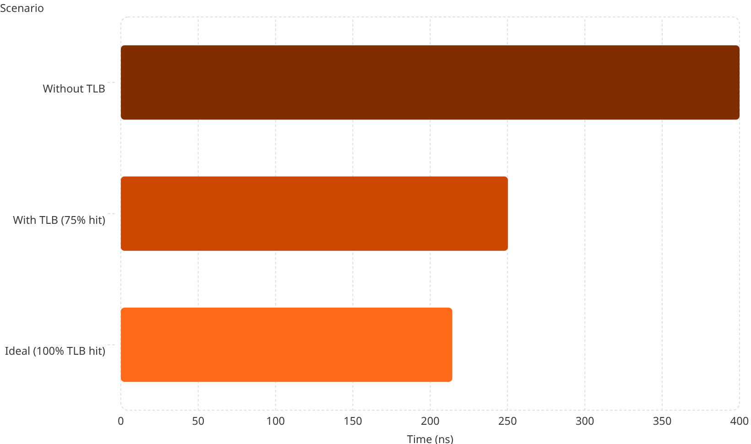
Problem Statement — Part B(ii): TLB Impact
TLB (Translation Lookaside Buffer) is a hardware cache that stores recent page-table entries. With TLB:
75% of references found in TLB → TLB access = 0 ns
25% of references miss TLB → requires memory access
Memory reference time = 200 ns
Effective Access Time (EAT): EAT = (0.75 × 200) + (0.25 × 400)
EAT = 150 + 100 = 250 nanoseconds

Slide 9
TLB Performance Summary
400ns
250ns
Without TLB
With TLB (75% hit)
Two memory accesses required per reference
Effective access time with TLB optimisation
37.5%
75%
Time Reduction
TLB Hit Rate
Improvement achieved by adding TLB
Percentage of references resolved instantly
Adding a TLB reduces effective memory access time by over 37%, demonstrating why TLBs are essential in modern processors.

Slide 10
Program — Paging System with TLB (C Code)
#include <stdio.h>
int main() {
float hit_ratio = 0.75;
int memory_time = 200;
int hit_time = memory_time;
int miss_time = 2 * memory_time;
float emat = (hit_ratio * hit_time) + ((1 - hit_ratio) * miss_time);
printf("Effective Memory Access Time = %.2f ns\n", emat);
return 0;
}
Code Explanation
TLB Miss
Only 1 memory access (200 ns)
2 memory accesses (400 ns)
EMAT Formula
Weighted average of hit and miss

Slide 11

Conclusion:
Paging Purpose
Key Calculations
Page tables enable non-contiguous memory allocation and virtual-to-physical address translation.
Without TLB: 400 ns. With 75% TLB hit: 250 ns — a 37.5% improvement.
TLB Importance
TLBs are critical hardware caches that dramatically reduce effective memory access time.
Key Takeaway: Paging with TLB is a foundational optimisation in modern OS design, balancing flexibility with performance.

Slide 12

Thank You

